Slide 1
Vaccine Allocation & Ordering System (VAOS)

Slide 2
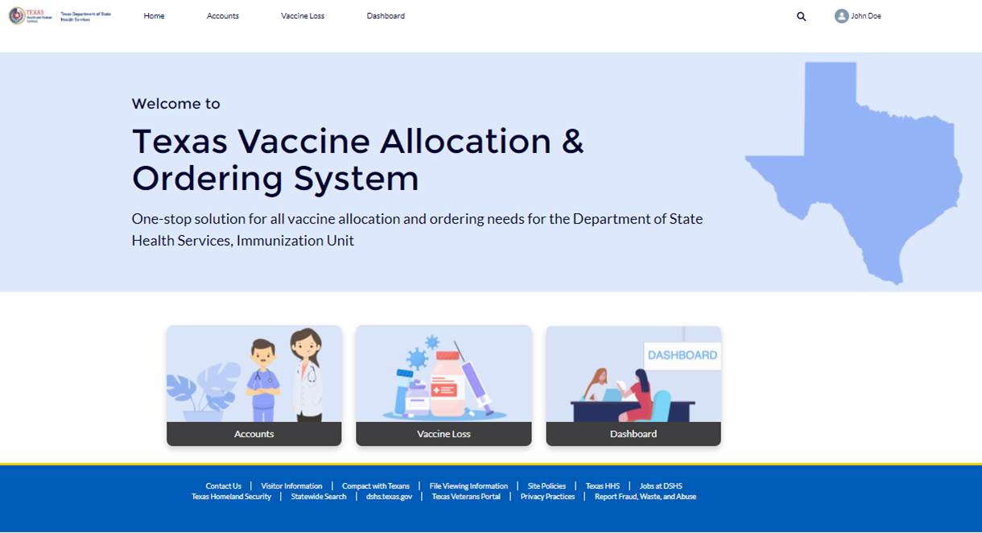
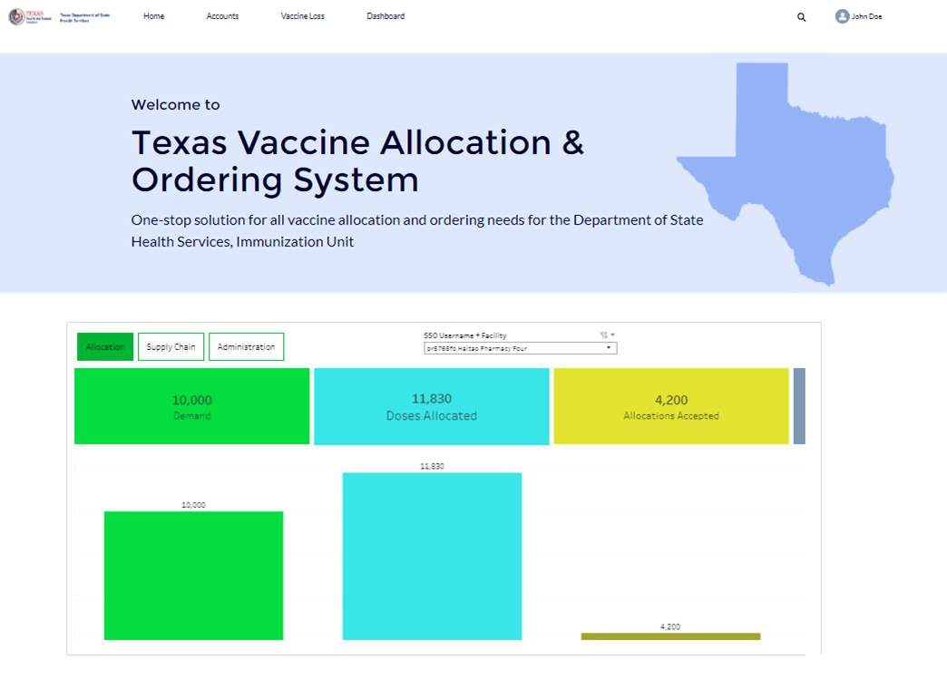
Overview
As a COVID-19 Vaccine Provider, you will use the Vaccine Allocation & Ordering System (VAOS) and Vaccine Management Dashboard to perform tasks related to COVID-19 vaccine management.
In VAOS, you will be able to acknowledge vaccine allocations, confirm received shipments, view distribution information, and report waste.
The Vaccine Management Dashboard is accessed through VAOS and allows you to monitor your vaccine allocations, distribution supply, and administration metrics.
Notes:
Speaker Notes:
VAOS is the system through which you will take all actions pertaining to vaccine ordering, such as acknowledging your allocations, confirming your shipments, and reporting your waste
The Dashboard is a tool that you can also access through VAOS—it will be useful in the coming months to monitor your vaccine allocations, distribution supply, and administration metrics

Slide 3
Understanding your Provider Actions in VAOS
As a Provider, you have four primary functions in VAOS:
ACCESSING DASHBOARDS
Useful for seeing your allocations, distribution supply, and administration metrics
ACKNOWLEDGING ALLOCATIONS
Required for your allocated vaccine doses to be submitted into the CDC ordering system
CONFIRMING SHIPMENTS
Required once you receive your vaccine doses
REPORTING
WASTE
Required to track how many doses are unused/wasted
Notes:
Speaker Notes:
Accessing dashboards – useful for seeing allocations distributon supply and admin metrics
Acknowledging allocations – once you receive allocaitons, acknowled and which sent to the CDC to get your shipment ready
Confirming shipments once vaccines arrive

Slide 4
COVID-19 Vaccine Provider Updates
If you have a COVID-19 Vaccine Provider account in VAOS:
Log into your COVID-19 Vaccine Provider account in the Vaccine Allocation & Ordering System (VAOS) ASAP to confirm your account information and ensure you have access. If you haven’t logged in, look for an email from IdentityManagement@hhsc.state.tx.us with your login credentials. We have sent instructions from COVID19VacMgmt@dshs.texas.gov on access.
If possible, mark noreply@salesforce.com as a safe-sender in your email system to avoid notifications about future allocations being sent to Spam.
Notes:
Speaker Notes:
Those of you who already have a VAOS account:
Make sure you log in ASAP to ensure you have access.
If you have not logged in yet, look for an encrypted email with your login credentials. We have also sent you an email from this mailbox – COVID19VacMgMt with instructions on how to access your account
Acknowledge the allocation you should have received yesterday
Follow the instructions we will share today to acknowledge your allocation

Slide 5
COVID-19 Vaccine Provider Updates
If you do not yet have a COVID-19 Vaccine Provider account in VAOS:
Once your account is ready, you will receive an encrypted email from IdentityManagement@hhsc.state.tx.us with your account information.
You will receive another email from COVID19VacMgmt@dshs.Texas.gov with instructions on how to access your VAOS account.
If possible, mark noreply@salesforce.com as a safe-sender in your email system to avoid notifications about future allocations being sent to Spam.
Notes:
Speaker Notes:
Those of you who do not yet have a VAOS account:
You will get 2 emails soon: once from DSHS confirming that you have an account, and one from COVID19VacMgmt with instructions on how to log in
Log in to ensure you have access to VAOS. You don’t need to confirm your allocations this week only
Monitor your inbox for the next round of allocations—you will need to acknowledge those

Slide 6
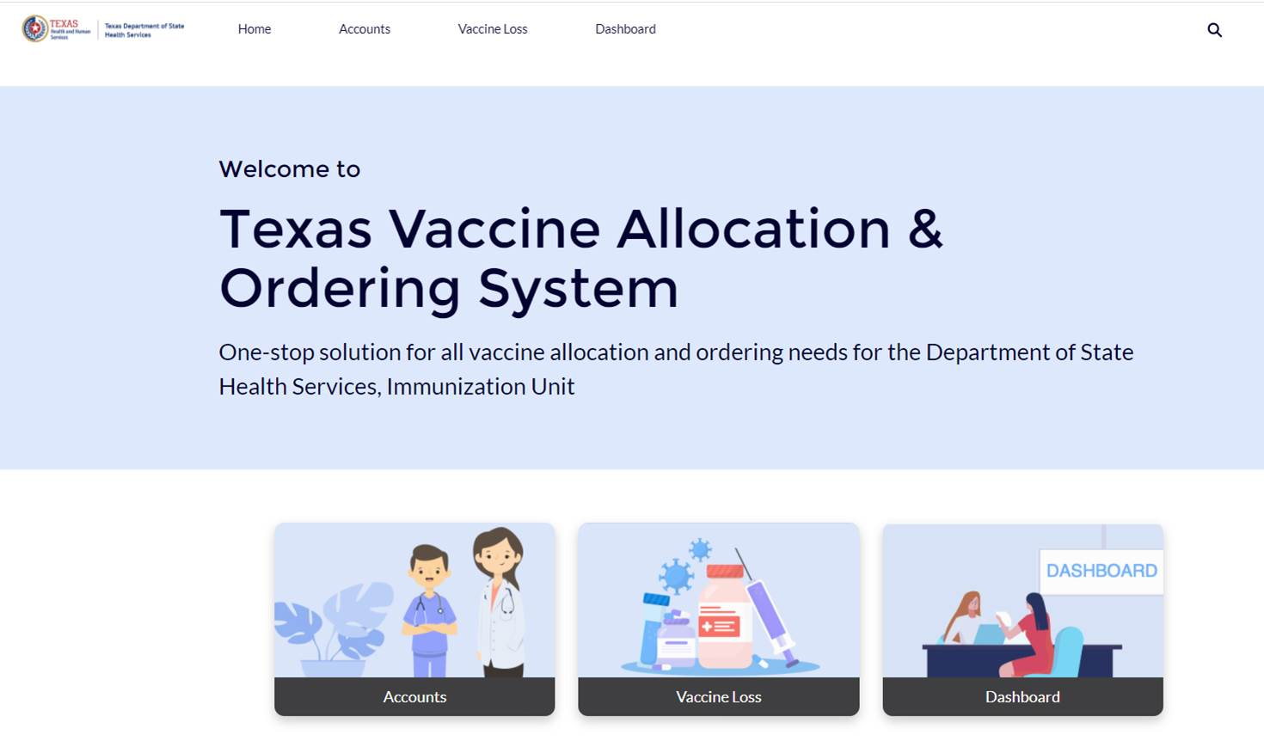
Logging into VAOS
To log into your VAOS account, go to https://texasvaccines.dshs.Texas.gov
Input your username and password
You will be brought to the VAOS Homepage, where you can navigate the Accounts, Vaccine Loss, and Dashboard views.
Notes:
Speaker Notes:
If you haven’t yet logged into VAOS, you will use an encrypted email to set up your password before accessing the log in screen above.

Slide 7
VAOS Tips & Tricks
Keep in mind…
VAOS works best with Chrome as your browser.
Please check your Spam folder for emails from noreply@salesforce.com as needed.
If possible, flag this address as a safe-sender to avoid emails being sent to Spam.
Regardless of the number of Providers or facility locations you are associated with, you will have one set of login credentials.
Notes:
Speaker Notes:
Chrome
The emails from noreply@salesforce.com have been known to go to spam (especially if you use gmail). See if you can mark this address as safe in your inbox
One set of credentials –

