Slide 1
C19 Therapies
Customer Ordering Process

Slide 2
C19 Customer Ordering
Process for Ordering Directly from AmerisourceBergen
Customers Order
Customers order directly using ABC Order Form
ABC Confirm Account
ABC Confirm Account and Max Quantities
Place Order
Using need by date, will create orders as appropriate
Ship / Deliver
Provide ABC Account when possible
Provide need-by-date to drive priority
Orders will ship within 1 business day of being created

Slide 3
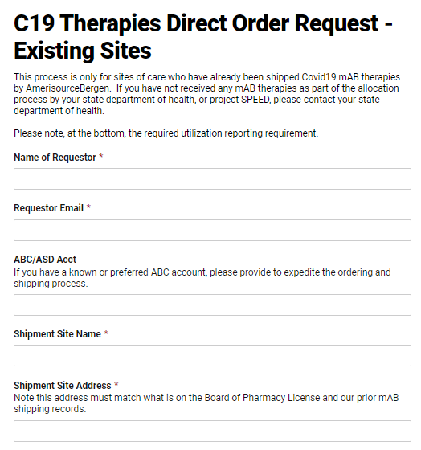
C19 Customer Ordering
Order Form
Who is submitting the request for mABs? Note that this contact information will be used to ensure utilization reporting.
Account and Facility information. Providing the ABC/ASD Account will accelerate the process. Account numbers look like 100XXXXX.

Slide 4
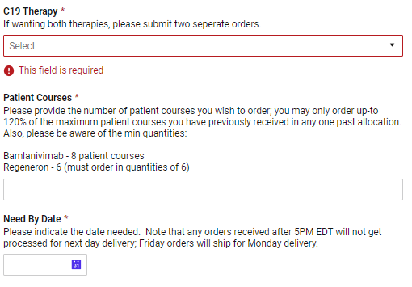
C19 Customer Ordering
Order Form
Select Therapy – If one or many are wanted, multiped orders must be submitted.
Patient Courses – Requested number of patient courses. Customer may only order up-to 120% of their largest past shipment.
Note the minimum order and requirement (at this time) to order in quantities of 6 patient courses for Regeneron.
Need by Date – we will attempt to accommodate and we ask that customers try to plan out a few days in advance, so we do not end up with all customers submitting next day urgent orders.

Slide 5
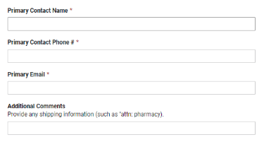
C19 Customer Ordering
Order Form
Contact Info – Name and contact information at the facility that we can coordinate delivery with if necessary. Large orders may require that we use a courier service and coordination.
Comments – Any additional comments such as specific delivery instructions.

Slide 6
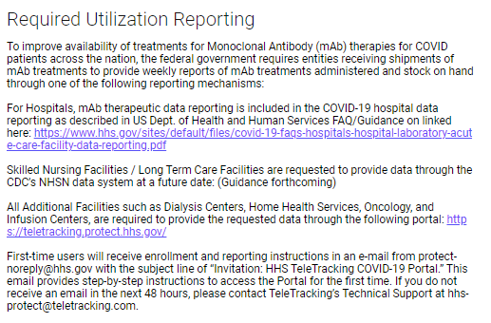
C19 Customer Ordering
Utilization Reporting Requirements
Reporting – Please also note that beginning on January 8, 2021, weekly reporting on these therapeutics including courses used and stock on hand is required through TeleTracking or NHSN (when therapeutic elements are available).
Instructions are at the bottom of the order form to register with NHSN or TeleTracking.

