Slide 1
Key Issues for Texas Hospitals
Outcomes for Texas Hospitals from the 86th Texas Legislature

Slide 2
Agenda
Texas Hospitals’ Policy Priorities for 2019-2020
86th Texas Legislature
New leadership
Caps on Property Tax Revenue
2020-2021 Budget
New Source of Trauma Hospital Funding
Surprise Billing
Behavioral Health
End-of-Life Care
THA-Supported Legislation
THA Resources

Slide 4
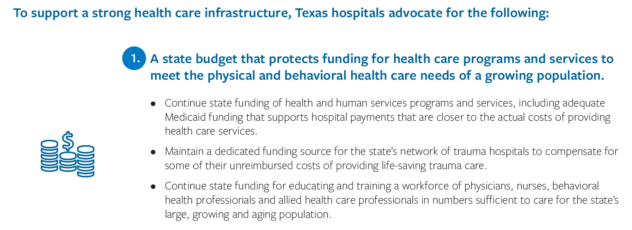

Slide 9
Notes:
Beginning Jan. 1 2019, Texas hospitals must publish online their standard charges for all items and services.
For several years, federal law has required Texas hospitals to publish and update lists of standard charges for items and services the hospitals provide. The new federal guidance creates more specific guidelines, which THA advocated against in discussions with the Centers for Medicare & Medicaid Services.
THA opposes a chargemaster because the tool is complex and often fails to help patients make meaningful comparisons among providers. Patients would be better served by comparing potential out-of-pocket costs for services and treatment, which are best made available by payers that have access to both hospital and physician charges and payments.
Nonetheless, THA is committed to helping Texas hospitals increase transparency around hospital charges and billing and strongly encourages all Texas hospitals to comply with the new federal chargemaster requirement.

Slide 10
86th Texas Legislature
Meets for 140 days every two years during odd-numbered years.
2019 legislative session: Jan. 8 – May 27.
THA tracked more than 1,500 of the nearly 7,500 health care and hospital-related bills that lawmakers filed.
Priorities for state leadership: must-pass 2020-2021 budget, state property tax reform and a stronger investment in school finance.
86th Legislature passed several bills important to Texas hospitals.

Slide 11
Leadership in the Texas House of Representatives
Speaker of the House
Dennis Bonnen (R-Angleton)
Rep. Senfronia Thompson (D-Houston)
Public Health Committee, Chair
Rep. John Zerwas (R-Richmond)
Appropriations Committee, Chair
Rep. Four Price (R-Amarillo)
Calendars Committee, Chair
Notes:
In the first week of session, the Texas House of Representatives unanimously elected Rep. Dennis Bonnen to serve as Speaker of the House. Speaker Bonnen then announced committee assignments for the 86th legislative session.
As expected, Rep. John Zerwas served again as chief budget writer over the House Appropriations Committee. Rep. Senfronia Thompson and Rep. Four Price took on new positions to chair the Public Health and Calendars Committees.

Slide 12
Leadership in the Texas Senate
Lt. Gov.
Dan Patrick (R)
Sen. Lois Kolkhorst (R-Brenham)
Health & Human Services Committee, Chair
Sen. Jane Nelson (R-Flower Mound)
Finance Committee, Chair
Sen. Kelly Hancock (R-North Richland Hills)
Business & Commerce Committee, Chair
Notes:
Lt. Gov. Dan Patrick announced committee assignments for the 86th Legislature.
Sen. Jane Nelson again served as chief budget writer and oversaw the Senate Finance Committee, and Sen. Kelly Hancock maintained his post as chair of the Business & Commerce Committee chair. Lt. Gov. Dan Patrick announced that Sen. Lois Kolkhorst would serve for the first time as the new chair for the Health & Human Services Committee, replacing former chair Sen. Charles Schwertner (R-Georgetown).

Slide 13
Caps on Property Tax Revenue
Limiting local governments’ ability to raise property tax rates was a priority for Gov. Greg Abbott and state leadership.
Proposed legislation sought to reduce the amount by which local governments, including hospital districts, could increase property taxes from 8 to 2.5 percent.
Caps threatened hospitals’ ability to generate revenue to provide the state share of hospitals’ supplemental payments and support indigent health care programs.
THA successfully worked to exempt hospital districts and county hospitals from SB 2, the property tax reform legislation that passed in May.
Notes:
One of the holdover issues that the legislature failed to resolve in the 2017 legislative session was the governor’s and legislative leadership’s priority to limit local governments’ ability to raise property tax rates.
Passing a bill to reduce residents’ property tax burden was nearly as important for the legislature as passing the state budget.
Such a reduction posed a significant threat to Texas hospitals’ ability to generate revenue to provide the state share of hospitals’ supplemental payments and support indigent health care programs.
Ultimately, lawmakers came to understand the devastating consequences the legislation could have on Texas hospitals’ ability to support the health care safety net and exempted county hospitals and hospital districts from the new, lower caps.

Slide 14
2020-2021 State Budget
The only bill lawmakers must pass each session.
Optimistic fiscal outlook: 86th Legislature had about $10 billion (16 percent) more to spend on public programs than for the 2018-19 biennium.
State lawmakers passed a $250.7 billion two-year budget and spent $84.4 billion in state and federal funds on health and human services.
Because of a more favorable federal match rate, a larger portion of Texas Medicaid will be funded by the federal government.
Notes:
The next two-year state budget is the one bill that lawmakers must pass each legislative session.
Lawmakers have about $10 billion more to spend than for 2018-2019.
With an allowed 16 percent spending increase over the 2018-2019 biennium, state lawmakers could cover existing expenditures and fund new items for 2020-2021.
The 86th Texas Legislature ultimately passed a $250.7 billion two-year budget—a preliminary amount that will change slightly after the governor’s June 16 deadline to complete line-item vetoes in the budget and approve all the other bills.

Slide 15
Hospital Funding in State Budget
Lawmakers funded the majority of Texas hospitals priority budget items.
Maintained state and federal funding for Medicaid rate enhancements:
$360 million for trauma hospitals.
$300 million for safety net hospitals.
$60 million for rural hospitals.
New state funding for rate enhancements for:
$35 million for rural hospitals’ inpatient services.*
$6.2 million for rural hospitals' labor and delivery services.*
$50 million for children's hospitals.*
$15 million in new grant funding to support infrastructure improvements at trauma hospitals.*
*Denotes state general revenue.

Slide 16
Hospital Funding in State Budget
Nearly half a billion dollar for inpatient and outpatient behavioral health care.
$445.4 million for phase II of the state psychiatric hospital redesign planning and construction.*
$26 million for 50 new inpatient beds at non-state psychiatric hospitals.*
$6 million to integrate the state's Prescription Monitoring Program for certain controlled substances with hospitals' electronic medical records.*
$5 million for substance use disorder treatment.*
$7 million for statewide maternal safety initiatives, which includes $3 million for TexasAIM to reduce preventable maternal mortality and morbidity.*
$19.9 million to help reduce the nursing workforce shortage.*
*Denotes state general revenue.

Slide 17
New Source of Trauma Hospital Funding
THA passed landmark legislation that provides a new, sustainable source of funding for Medicaid rate enhancements for Texas trauma and safety net hospitals.
HB 2048 repeals and replaces the primary source of revenue for the state’s trauma fund (Account 5111), which (when combined with federal funds) provides:
$176.4 million to offset trauma hospitals’ $320 million in unreimbursed trauma care costs.
$150.8 million for safety net hospitals.
Ensuring access to trauma care has been a priority for hospitals, lawmakers and other stakeholders for the past six years.
Notes:
One of the biggest winners of the 2019 session is access to trauma care.
Rep. John Zerwas (R-Richmond) and Sen. Joan Huffman (R-Houston) passed landmark legislation that repeals the much-maligned Driver Responsibility Program—the primary source of revenue for the state’s trauma fund (Account 5111)—while maintaining funding for the state’s more than 280 designated trauma hospitals.
Repealing the DRP and replacing its lost revenue for trauma hospital funding is an issue Texas hospitals, lawmakers and other stakeholders have worked to address for more than six years.
Revenue in the state trauma fund, when combined with federal funds, provides $176.4 million to offsets just over half of Texas trauma hospitals’ more than $320 million in unreimbursed trauma care costs.
In addition to trauma, the trauma fund also supports funding that, when combined with federal funds, provides $150.8 million for safety net hospitals to provide care to indigent and vulnerable populations.

Slide 18
Surprise Billing
Bipartisan and bicameral attention on eliminating surprise medical billing.
THA supported and helped pass SB 1264 to eliminate surprise bills for emergency or unplanned out-of-network health care services, while maintaining mediation for hospitals and health plans to negotiate a fair payment amount, free from government-set rate parameters.
As the issue of surprise billing gains increasing attention in the U.S. Congress, Texas’ new surprise billing law can serve as a model for the nation.
Notes:
SB 1264, by Sen. Kelly Hancock (R-North Richland Hills), Sen. John Whitmire (D-Houston), Rep. Tom Oliverson (R-Cypress) and Rep. Trey Martinez Fischer (D-San Antonio), prohibits surprise billing for emergency care and for out-of-network providers or for laboratory and imaging services originating from in-network facilities. The legislation creates a bifurcated system where hospitals and other facilities are subject to mediation, without government-set rate parameters other than usual and customary rate, while physicians and other health care providers are included in the arbitration requirement.

Slide 19
Behavioral Health
Priority legislation for THA’s Behavioral Health Council passed to streamline the admissions process at psychiatric hospitals for individuals seeking voluntary inpatient mental health treatment. (SB 1238)
Lawmakers also prioritized legislation to:
Delay from Sept. 1, 2019 to March 1, 2020 the requirement that all prescribers and dispensers to consult the state’s Prescription Monitoring Program prior to dispensing or prescribing certain controlled substances. By March 2020, funding is available to integrate hospitals’ EMRs with the PMP. (HB 3284)
Connect Texas medical schools and other providers to improve children’s access to behavioral health care as a way to prevent school shootings. (SB 11)
Curb prescription drug misuse and diversion by requiring e-prescribing for controlled substances, limiting opioid prescriptions to 10-days for acute pain and requiring the state to cover medication-assisted treatment without a prior authorization. (HB 2174)
Notes:
SB 1238, by Sen. Nathan Johnson (D-Dallas)/Rep. Toni Rose (D-Dallas), would streamline the process for psychiatric hospitals to admit an individual requesting inpatient mental health treatment and expedite access to and increase continuity of care. Under this bill, Texans needing inpatient mental health treatment the care they need more quickly.
A number of bills were filed this session governing court-ordered mental health services, processes for temporarily holding individuals in need to emergency mental health treatment, including children and individuals with a cognitive disability and circumstances in which a provider may disregard a declaration for mental health treatment.
In August 2018, the Texas Hospital Association hosted a forum for behavioral health hospitals and stakeholders to discuss challenges in access to appropriate care for individuals who present to the emergency department for involuntary mental health treatment and potential solutions.
As a result of that work, THA worked with the Office of Court Administration, under the Supreme Court of Texas, and legislators on a long-term solution to access to and coordination of court-ordered mental health care. THA will work with the appropriate state agencies to implement efforts through rulemaking during the 2019-2020 interim.

Slide 20
THA-Supported Legislation
THA successfully passed priority legislation to:
Expand liability protection for volunteer providers and facilities that sponsor them to ensure timely access to essential health care during a disaster. (SB 752)
Align state and federal reporting requirements for health care-associated infections so hospitals can better focus on infection control and prevention. (SB 384)
Ensure that Texas hospitals receive fair reimbursement for health care services—regardless of where the care occurs in the hospital—provided to a patient injured because of another person’s fault or negligence. (HB 2929)
Notes:
SB 384, by Sen. Jane Nelson (R-Flower Mound), aligns state and federal reporting requirements for health care-associated infections. This legislation reduces administrative burden so hospitals can focus on their infection control and prevention efforts.
SB 752, by Sen. Joan Huffman (R-Houston)/Rep. John Oliverson (R-Cypress), expands liability protection for volunteer providers and facilities that sponsor them to ensure timely access to essential health care services during a disaster. This effort became a priority after Texas hospitals identified lessons learned from Hurricane Harvey.
HB 2929, by Sen. Kelly Hancock (R-North Richland Hills)/Rep. Jeff Leach (R-Plano), which would clarify existing state law to ensure that Texas hospitals can attach liens to personal injury settlements in order to recoup the costs of treatment—regardless of where the care occurs in the hospital—provided to individual who are injured as a result of another’s negligence.

Slide 21
End-of-Life Care
THA stopped several efforts to undermine the Texas Advance Directives Act, patients’ free will and physicians’ professional autonomy. Two bills sought to force physicians and nurses to perform medical interventions indefinitely on terminally ill patients. Specifically, they would have amended the TADA to:
Require a hospital—even after its committee of medical ethicist and physicians, under the dispute resolution process, determines further medical interventions would harm the patient—to continue providing medical interventions until the patient is transferred to another facility that is willing to provide medical interventions.
Define reasonable medical judgment and make the state’s dispute resolute process more prescriptive and limit providers’ ability to honor patient wishes.
Notes:
Legislation governing end-of-life care always is a hot-button political issue, and the discussions this session were no exception. Several bills sought to revise Texas’ current law on advance directives and medical powers of attorney, but state lawmakers weren’t able to push anything over the finish line, and the Texas Hospital Association was heavily involved in helping stop the bad bills.

Slide 22
Bills That Did Not Become Law
Just as important as the bills that passed are the ones that did not become law. Each session, THA works to stall legislation that is bad for Texas hospitals.
Among the legislation that failed are THA-opposed bills that would have:
Restricted the ability of local governments, including hospital districts and county hospitals, from engaging in issue advocacy for the betterment of their communities.
Undermined Texas’ strong medical malpractice law by increasing the current limits on payments for non-economic damages.

Slide 23
THA Resources

Slide 24
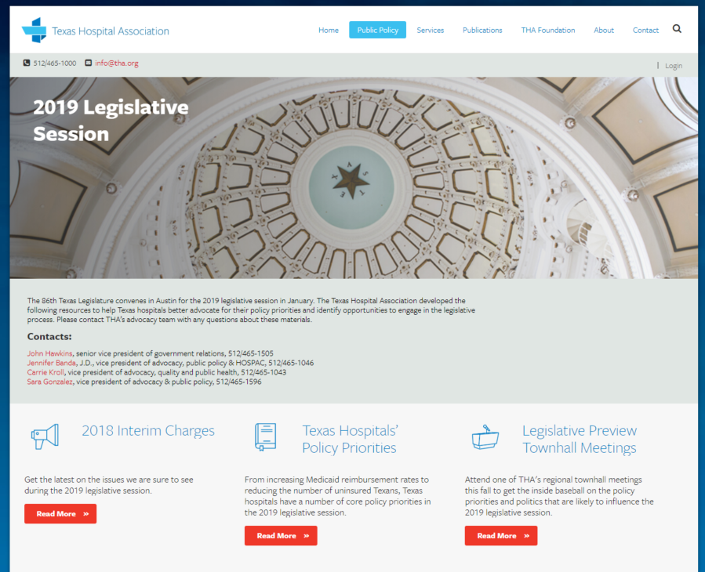
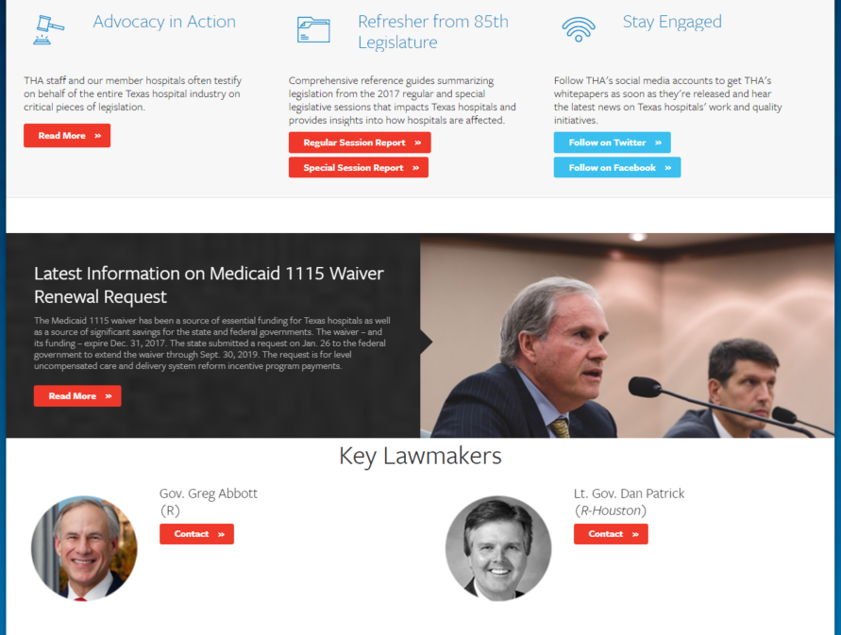
One Stop For Legislative Information
VISIT ONLINE
www.tha.org/2019legislativesession
Notes:
Each legislative session, THA provides updates and resources to keep hospital leaders engaged in the Legislature’s activity related to hospital and health care policy and funding.
THA’s full report summarizing outcomes for Texas hospitals from the 86th Texas legislative session as well as Texas hospitals’ policy priorities for 2019-2020 and more is available at www.tha.org/2019legislativesession.

Slide 25
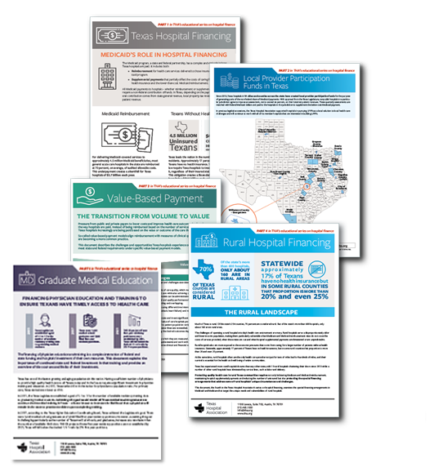
Educational Series on Hospital Finance
Medicaid’s Role in Hospital Financing
Local Provider Participation Funds
Value-Based Payment
Rural Hospital Financing
Graduate Medical Education
Hospital Payment Sources
www.tha.org/hospitalfinance
Notes:
The Texas Hospital Association recently launched an educational series on hospital finance.
The series is designed to explain policy makers, hospital leaders and health care consumers the intricacies of how hospitals are paid and their own financial investment in the work they do.
The explainer documents provide an overview of where hospital payments come from, Medicaid’s role in hospital finance, the funding challenges rural hospitals experience, hospitals’ investment in physician training and education and other critical elements of hospital finance.
The series is available online at www.tha.org/hospitalfinance and from THA’s Legislative Session App.

