Slide 1
Wixted & Company
THA Communications Summit
March 2026

Slide 2

Who We Are
Wixted & Company is a full-service strategic communication firm.
Trusted resource
Communicate with purpose, strength, clarity to achieve your goals
Analyze your stakeholders to impact the customer journey
Strategic counsel, crisis and issues communication, internal/external communications, media relations, training and video

Slide 3





Our Clients
MANUFACTURING
NUCLEAR
& ENERGY
HEALTH CARE
AGRIBUSINESS
INSURANCE

Slide 4
What We Do
1
STRATEGY & COUNSEL
2
WRITING, MEDIA RELATIONS & VIDEO SERVICES
3
COMMUNICATION TRAINING
4
CRISIS COMMUNICATION

Slide 5
The Balancing Act
OPERATIONS
COMMUNICATIONS

Slide 6


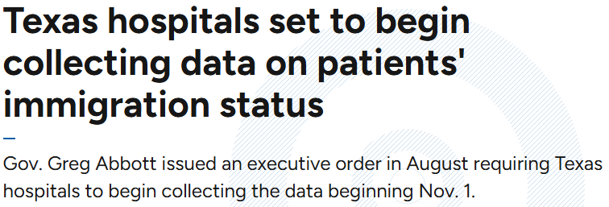

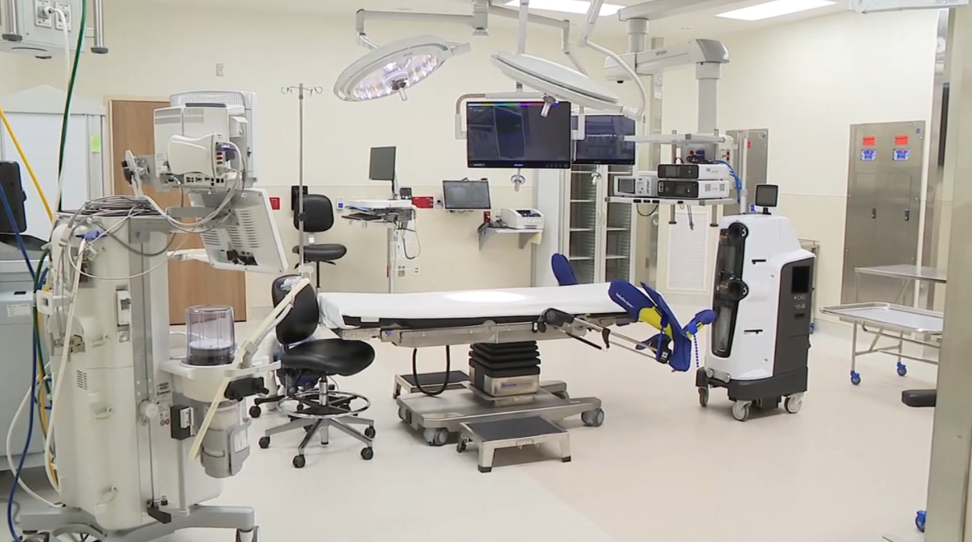

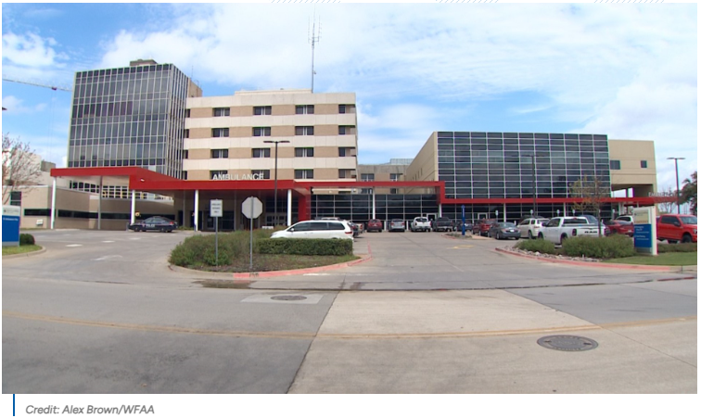

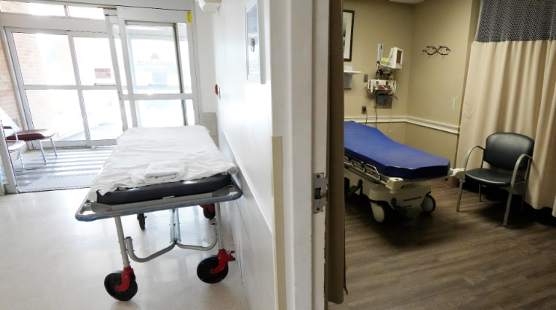
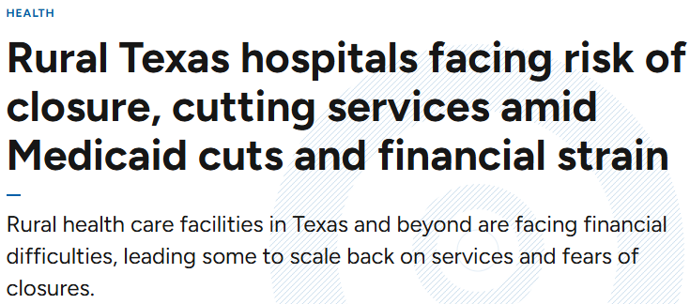
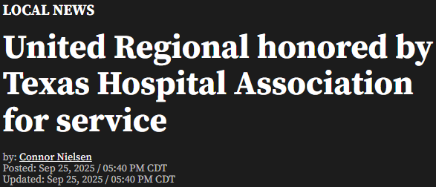

Slide 7
HOW AN ISSUE BECOMES A CRISIS
INCIDENT
ISSUE
CRISIS
ISSUE
CONTROVERSY

Slide 8
SEAT AT THE TABLE
Expertise
Change Communication
Issues Crisis Readiness
Build Connection
Compelling
Communicators

Slide 9





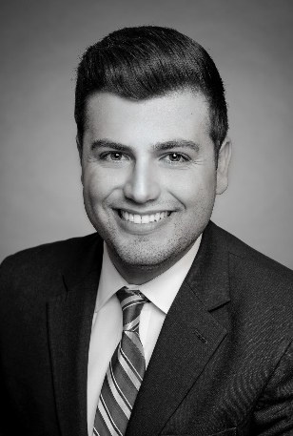












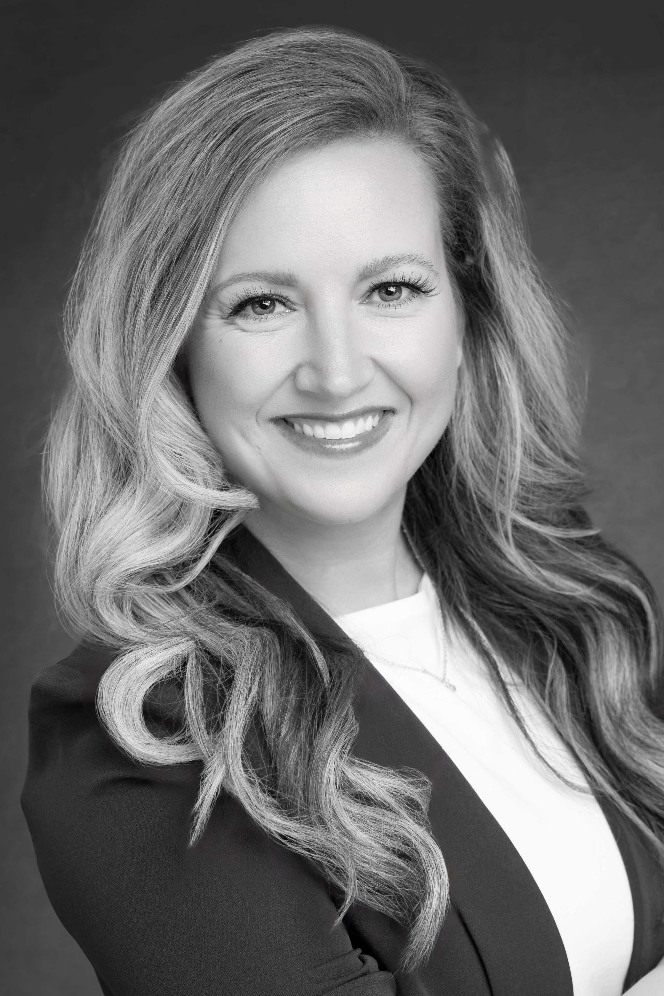

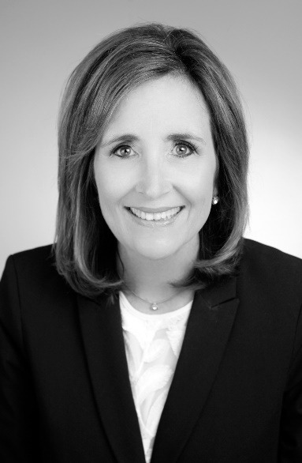
WIXTED TEAM

Slide 10





WIXTED & COMPANY SERVICES
STRATEGIC COMMUNICATION PLANNING
CRISIS AND ISSUE COMMUNICATION
MEDIA RELATIONS
VIDEO SERVICES
www.thinkwixted.com

Slide 11
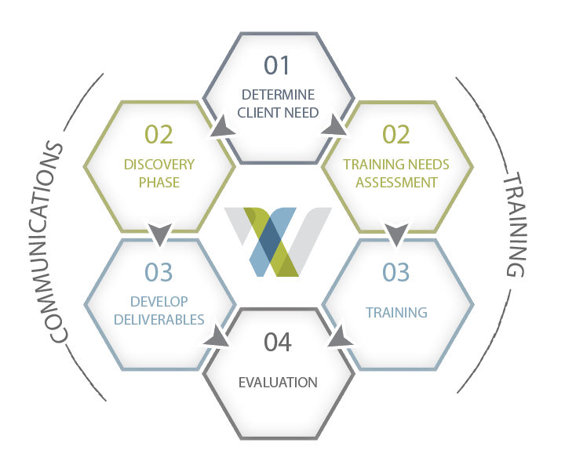
WIXTED & COMPANY PROCESS
ISSUE

Slide 12





YOU
NET IMPRESSION
MESSAGE
AUDIENCE
BUSINESS GOAL
To inform? To persuade? To motivate?

