Slide 1


Hill Country Floods
A Hospital Comms Perspective
Tim Rye, Chief Strategic Development Officer

Slide 2


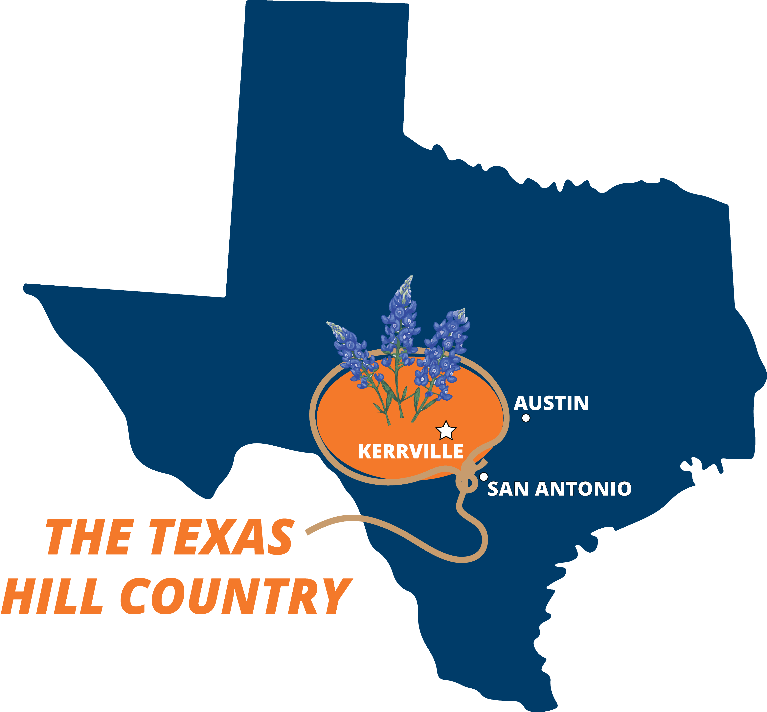

Who is Peterson health
Established 1949
Kerrville, Texas
Private, Nonprofit Organization
1,300+ Employees
Serving Kerr County + 9 Surrounding Counties
Population: 54,902 (as of 2024)
  Catchment Area: 120,000
18 Rooftop Regional Footprint

Slide 3
July 4th, 2025
Day of… Not what anyone expected…
Hospital Incident Command
Southwest Texas Regional Advisory Council (STRAC)
First patients arrived via ambulance around 8am – 4 people, none related
All told, 12 patients hospitalized, 48 treated in ER
Unknown number transported to San Antonio for higher levels of care
We only received what was triaged out of the field, lots of coordination between STRAC and local emergency response.

Slide 4
Working through the Chaos
Nobody went to bed on Thursday night expecting this…
There was no preplanning the scenario, we expected 3-4 inches of rain overnight. We received 12 inches concentrated in the worst possible location for this “perfect storm”
By 10am, hospital was inundated with calls from people looking for loved ones.
By noon, I had over two dozen messages from media outlets - local, state and national
By early afternoon, reporters showing up asking questions

Slide 5
Working through the Chaos
Coordination with local fire departments in seven jurisdictions
Formal centralized Incident Command still coming together
Supply chain still not organized
Non-Governmental resources turning to us for help (supplies, medical support, expertise)
Many of the local fire departments are volunteer organizations. Amazing people, limited expertise

Slide 6
Week One – A day in the life
5am – Assemble at centralized Incident Command for debrief from local, state, and federal agencies. Leave with several requests that cannot be supported yet by government response. Mostly supply/equipment needs.
7am – Review phone messages, emails, text inquiries from media and various other entities
8am – Debrief hospital leadership on latest developments
9am – Debrief system department directors/managers
10am – Respond to media inquiries, do interviews, coordinate meal deliveries, organize supply donations, respond to community requests
BLINK, its 6pm – back to IC to debrief
7pm – Review phone messages, emails, etc.

Slide 7
Week One – A day in the life
9pm – Eat your first real meal of the day
11pm – Go to bed, lay there thinking of all the things you still need to do
3:45 am – Get up and start it all over again
On Friday July 11, after the morning IC debrief finally went home to rest at 10am. Fell asleep around 10:30am, woke up at 3am Saturday in the largest pile of drool I’ve ever seen.

Slide 8
Other Community Support
Vaccine distribution
First Responder Care Kits
Salvation Army volunteers
IV stations
Supplies, Supplies, Supplies

Slide 9
TAKE AWAYS
In these types of disasters, in an isolated rural area, it takes days before the response feels any kind of organized.
Stakeholders turned to the hospital for guidance, supplies, manpower.
There is no roadmap, just one in the moment problem to solve after the other.
The media is sneaky, develop a plan to protect your patients. DO THIS EARLY ON! Don’t let them bully you…
Don’t feel compelled to accommodate every media request. Be strategic. I prioritized local first, regional next, State next, national last. Highlight the great work of the team.

Slide 10
TAKE AWAYS
The “fog of war” is real, especially in the first several days. Lots of cooks in the kitchen.
Keep the entire organization informed with as many details as possible. This disaster happened to all of them. Everyone knows someone who perished, lost a house, a car, a pet, etc. Its personal to everyone.
Leverage social media and website, coordinate efforts with local city/county/Fire/EMS/Police officials.
Try not to let yourself work to exhaustion. Easier said than done…Events like this impact you too.
Your team needs to feel like they are doing something, find creative ways to accommodate that.
Be prepared for milestones.

Slide 11


