Slide 1
Engaging with THA in the Interim
Julia Mann (jmann@tha.org)

Slide 2

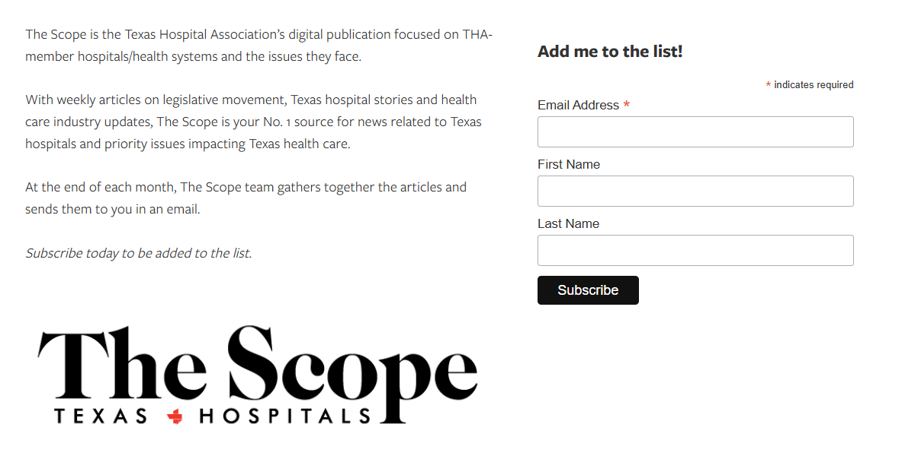
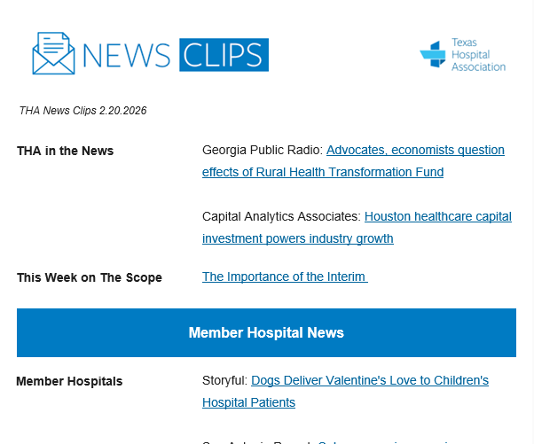
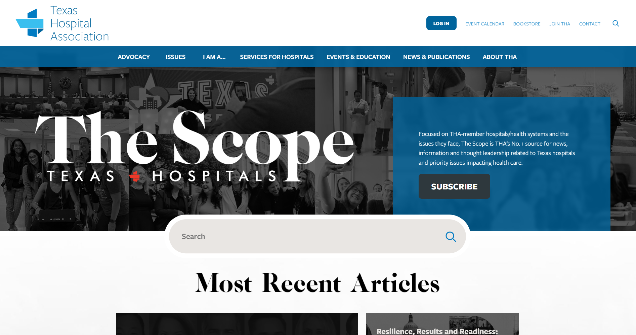

Staying Informed with THA
The Scope: Weekly on the THA website
The MicroScope: 1st Tuesday @ 9am on LinkedIn
Scope Recap Email: End of the month in your inbox
Health Care Advocate: Thursdays @ 6pm in your inbox
News Clips: Fridays @ 8am in your inbox

Slide 3





Annual Collaborative Campaigns
Incoming Board Chair Launch
Now Boarding – New Board Members
Women to Now (during session)
Hospital Week
Summer Heat Messaging
Hispanic Heritage Month
Halloween
Veteran’s Day
Health Care Heroes!
Look out for calls for quotes or content for other issue/topic-specific articles!

Slide 4
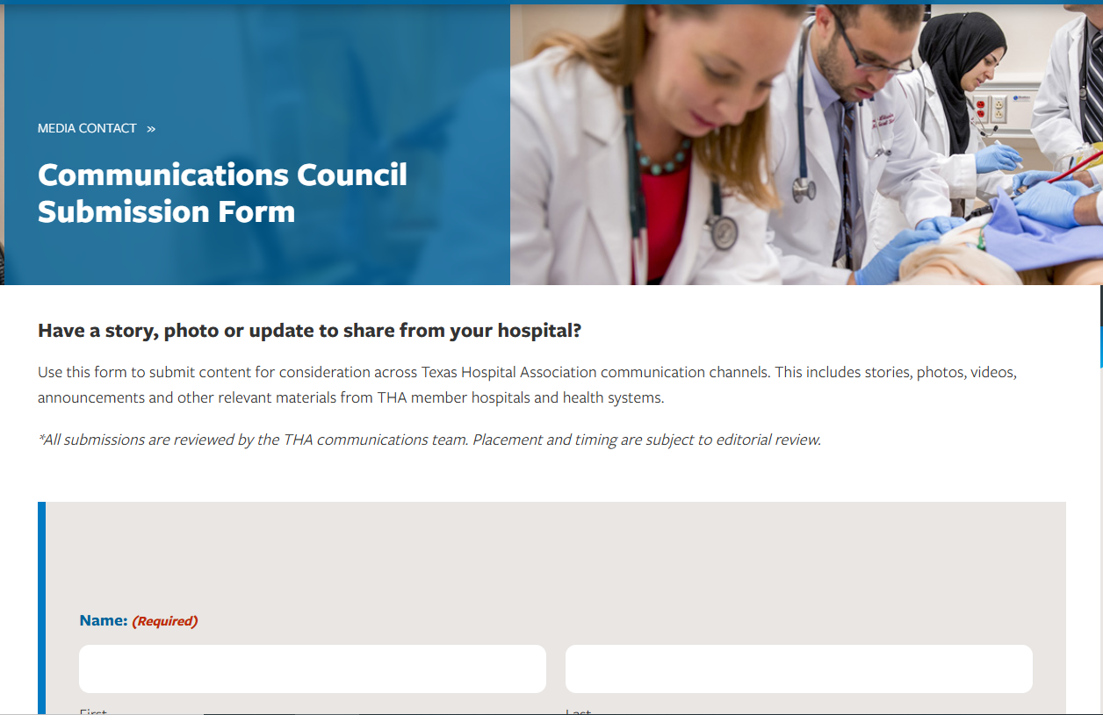

Sharing Your News with Us
New! Content Submission Form
Add our team to your PR list
Tag THA on social media (even in the comments)

