Slide 1
Communicating Quality
Collaborating with Clinical Teams
Sheila Dolbow, RN and Nina Costilla, RN

Slide 2
Learning Objectives
Identify strategies for building trust and psychological safety before, during, and after conversations/interviews
Recognize opportunities to translate clinical expertise into accessible, accurate, public-facing language
Develop a practical approach to partnering with clinical care teams

Slide 3
Where do we intersect?
Shared Purpose: Advocacy and Healing
Nursing: Quality patient care
Communications: Storytelling and Preservation
Notes:
Both protect and honor dignity, safety, and trust

Slide 4
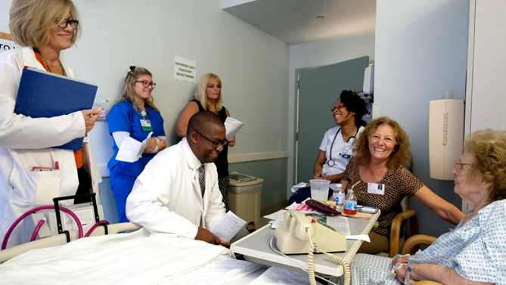
Know and understand clinical teams
Care teams prioritize patient care
  Patient and Staff safety
A care provider’s time is:
  Limited
  Valuable
  unpredictable
High emotional labor
  Clinical care can be emotionally challenging
  Respect for patients, families, staff
Notes:
Nursing mindset; there are a lot of us! Tend to think only about nursing
Authentic connection requires recognition and consideration for how nurses interact within healthcare and perceive their place in it
Photo: https://www.1unit.com/blog/elevating-patient-care-the-crucial-role-of-interdisciplinary-bedside-team-rounds

Slide 5
Be present
Attend huddles and staff meetings
Round with clinical leaders
Spend time on units (without a camera or recorder)
Learn clinical language and ask thoughtful questions

Slide 6

Ask the right questions
Open ended and elicit thoughtful answers
“Tell me about…”
Then be prepared to listen!
Ask follow up questions
Avoid explicitly asking for a certain story
  Heartwarming
  Dramatic
  Traumatic
  Inspiring
Notes:
a patient interaction that has stayed with you
a time you feel you made a difference.
a moment that reminded you why you became a nurse
Honor where they are in their living/lived experience
What were your thoughts at that moment? Feelings, senses…?
What did you notice about the patient/family reaction? Or your own or other staff?
Why do think that moment stayed with you?
And then be ready to listen, they can be heavy stories
“What happened next?”“What were you thinking in that moment?”“What did you notice about the patient’s reaction?”“If I had been standing there, what would I have seen?”“Why do you think that moment has stayed with you?”

Slide 7
Translate clinical impact to human language
Healthcare professionals speak in clinical detail and communicators translate into emotional clarity
Clinical: “We initiated a rapid response within 3 minutes.”
Storytelling: “Within moments, the team moved with exact precision, as every second mattered.”
Bridge the gap by:
  Clarifying and confirming clinical accuracy
  Avoid oversimplification

Slide 8
Storytelling
Be true to lived experience
Elevate team’s impact
Advance safety and quality of care
Support the organizational mission
Focus on system learning

Slide 9

Storytelling
Highlight
Avoid
Clinical expertise
Critical thinking
Interdisciplinary collaboration
Leadership at the bedside
Patient advocacy
Simplification
Assumptions
Stereotypes

Slide 10

Maintain ethical boundaries
Follow HIPAA guidelines
Obtain proper consent
Do not pressure patients, families, or staff
Avoid dramatizing adverse events
Trauma-informed approach

Slide 11
Trauma-informed
Remember - patient stories often involve
Loss
Errors High-acuity situations
Moral distress
Second victim
Best Practices
Ask permission
Observe body language
Recognize when to stop
Debrief after interview when appropriate

Slide 12
Make it easy to participate
Clinical teams are busy!
Offer flexible interview options
Provide question outline in advance
Keep interview precise and on time
Obtain and maintain consent
Offer to draft and allow review for clinical accuracy
Notes:
Offer to draft and allow review for clinical accuracy

Slide 13

Close the loop
Share the final product
Thank participants personally and recognize them publicly when appropriate
Track impact
  Engagement, awards, policy change
  Show how storytelling advances patient safety and awareness
Notes:
Builds trust and collaboration

Slide 14
Group Activity
How would you tell this story?
How would you collaborate with clinical staff?
What questions would you ask?

Slide 15


Slide 16
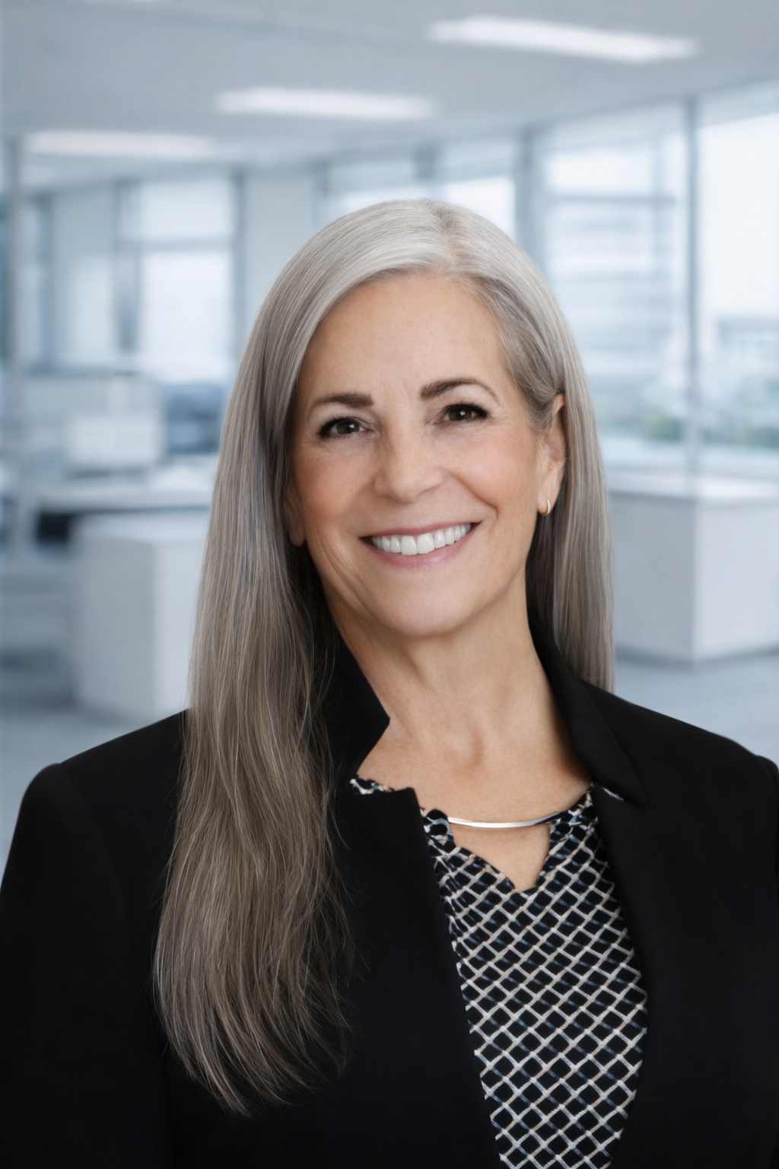
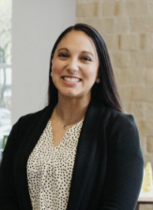
Thank you!
Sheila Dolbow
RN Program Manager
sdolbow@tha.org
Nina Costilla
RN Program Manager
ncostilla@tha.org

