Slide 1






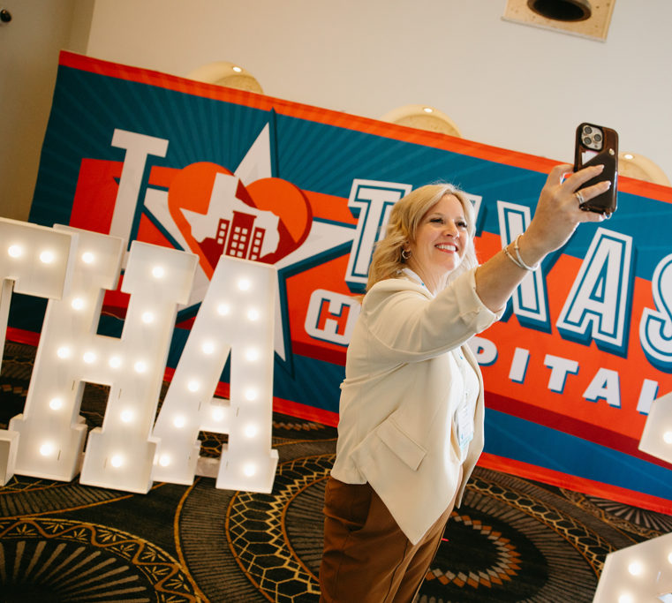
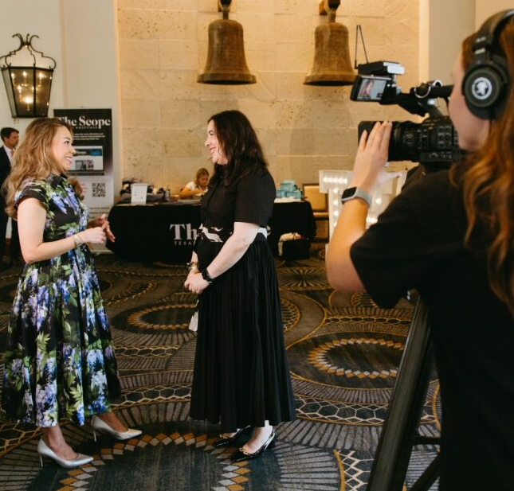
THA 2026: Comms Presence & Strategy

Slide 2




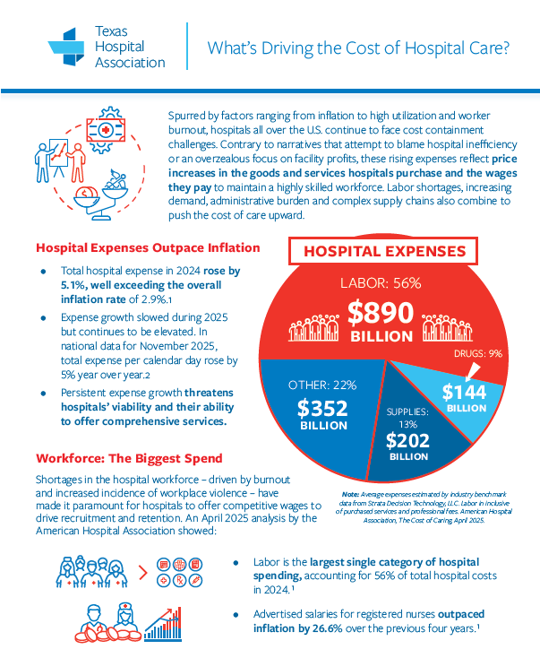




Communication: Critical Arm of Lobby Strategy

Slide 3
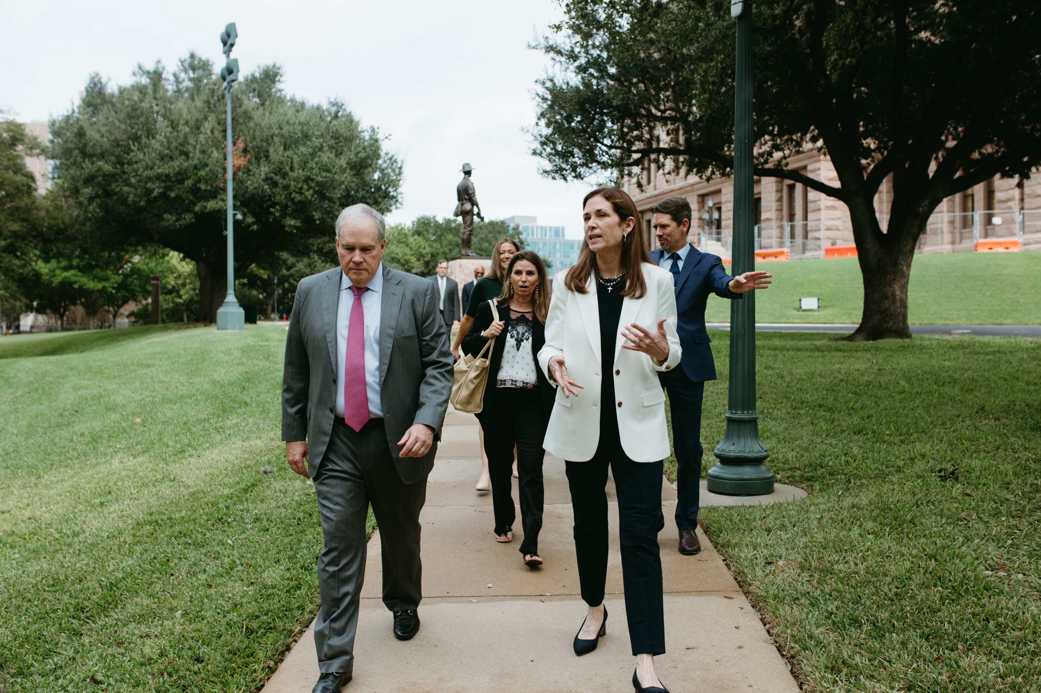







COMMS 2026
LEADERSHIP LAUNCH

Slide 4

COMMS 2026
POSITIONING LEADERS

Slide 5
COMMS 2026
PROOF OF IMPACT

Slide 6
COMMS 2026
ADVOCACY DRIVEN

Slide 7
COMMS 2026
FASTER, FURTHER

Slide 8
COMMS 2026
AUTHENTIC
& LEADING-EDGE

Slide 9
COMMS 2026
COMMS SUMMIT

Slide 10
COMMS 2026
LEADERSHIP LAUNCH
For 2026, THA leveled up its board chair platform to include deep-dive features, a yearlong flight of videos, enhanced digital/social and a more intentional focus on the Board’s advocacy platform as well as our chair’s personal vision and backstory.
INTRODUCING CRIS

Slide 11
COMMS 2026
POSITIONING LEADERS
For 2026, THA launched a new digital campaign focused on the introduction of our nine new board members. This authentic, personal content performs well in the age of AI, signals momentum, engages leaders and inspires others to step up.
NOW BOARDING

Slide 12
COMMS 2026
PROOF
OF IMPACT
With 2025’s extreme challenges – and an imminent dues increase – THA put its annual report on steroids. It leans into authentic faces, compelling data points and colorfully memorializes THA’s key wins and tools for hospitals.
Note: In an extremely politically divisive year, we retained 100% of our membership.
ANNUAL REPORT

Slide 13

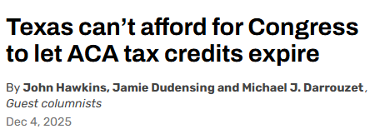

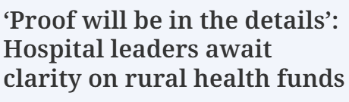

COMMS 2026
ADVOCACY DRIVEN
For 2026, the cost of health care is our centerpiece issue. THA’s advocacy comms strategy is focused on cost, insurance, workforce, charity care, rebasing, government spending/tax caps and behavioral health. Our messaging is detailed, proactive and punchy.
ADVOCACY ISSUES

Slide 14
COMMS 2026
FURTHER,
FASTER
For 2026, THA Comms has implemented AI-powered technology to help ensure THA is a major digital voice of authority in health care. We are extending our reach on tough issues without sacrificing credibility. THA’s messaging and analytics are competitive nationally.
Benchmarking against: TAHP, BCBS, AHA, AV, ACHE, TAB, others
EXPAND REACH

Slide 15
COMMS 2026
AUTHENTIC
& LEADING-EDGE
Informed by analytics and a scrappy, innovative team, THA Comms uses authentic photography, advocacy depth, poignant storytelling and cutting-edge graphics to stay ahead of adversaries. We are maximizing our presence through digital algorithms, including AI crawlers.
AUTHENTIC & EFFICIENT

Slide 16
COMMS 2026
COMMUNICATORS SUMMIT
We’re there! THA’s third annual Texas Hospital Communicators Summit engages hospital comms execs in advocacy issues and unifies the industry in a forward-facing way. This year’s agenda focuses on comms trends, AI, innovation and fresh voices from the next generation of health communicators.
COMMS SUMMIT

Slide 17

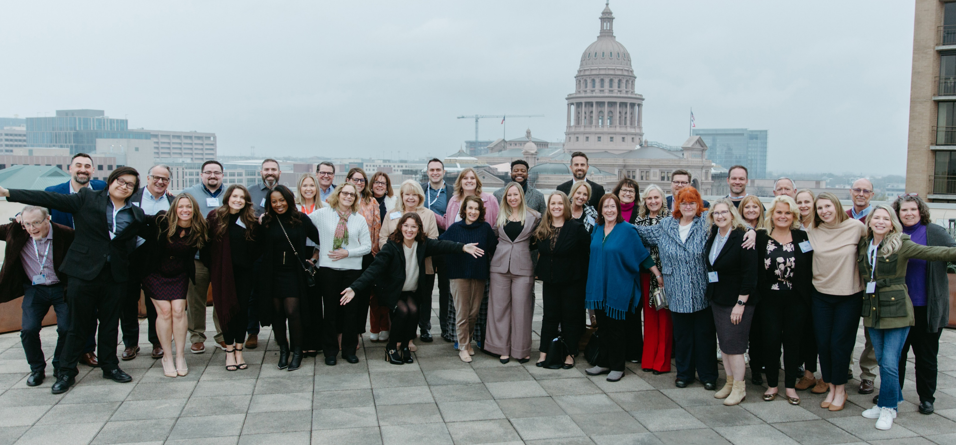

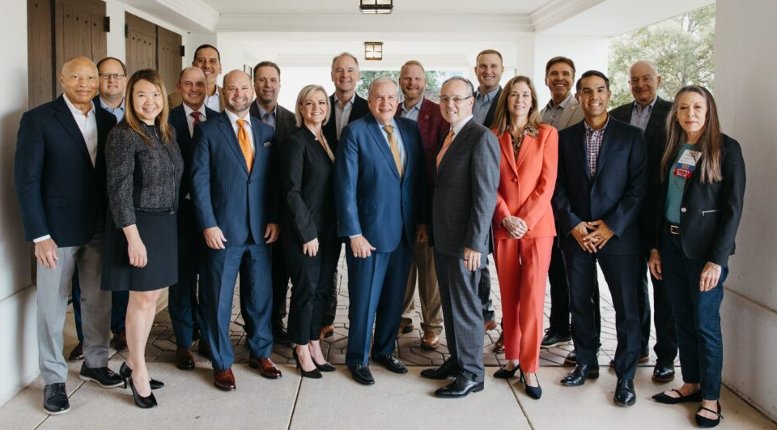
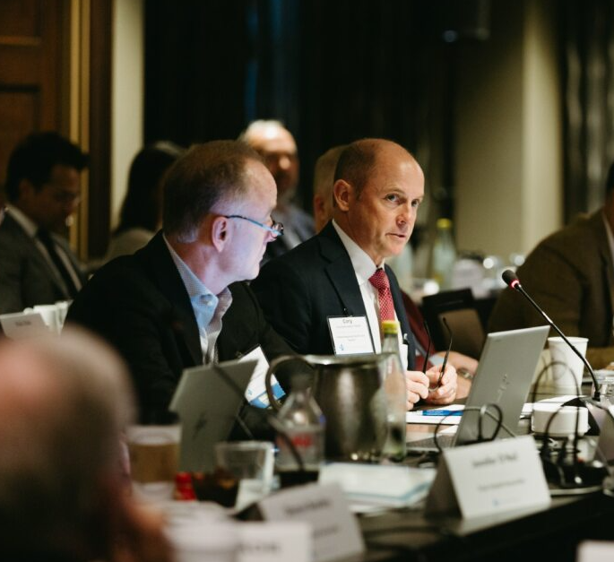
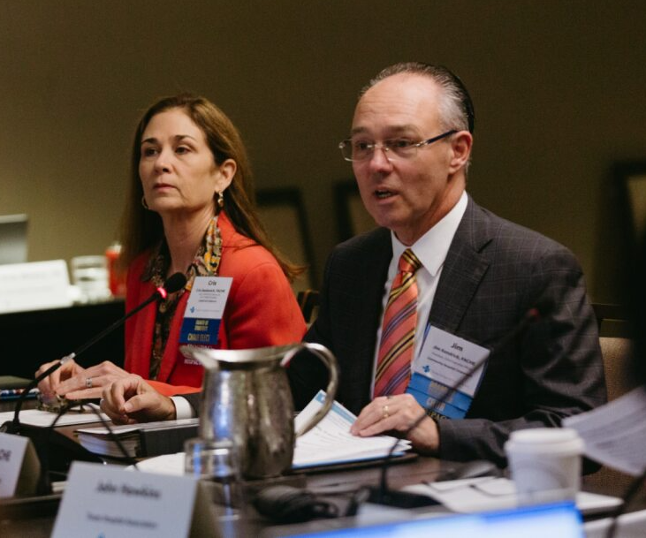
THA Board + Comms: Leaders in Action

